Slide 1
Effective Communication in Healthcare Settings
Michael Richardson, MPA
January 23, 2020

Slide 2
Session Agenda
Relevant Federal Disability Discrimination Laws
ADA requirements for Effective Communication
Vision/Blind and Effective Communication
Cognitive disabilities and Effective Communication
Deaf/Hearing loss and Effective Communication
Establishing an Effective Communication Office Policy
Resources

Slide 3
Federal Disability Discrimination Laws
Title II of the Americans with Disabilities Act – applies to all public (state and local) healthcare providers.
Title III of the Americans with Disabilities Act – applies to all private healthcare providers.

Slide 4
Federal Disability Discrimination Laws
Section 504 of the Rehabilitation Act of 1973 – applies to federal healthcare services and facilities; and healthcare providers who are also recipients of federal financial assistance, (such as federal Medicaid funds) or by federal research grants.
Section 1557 of the Affordable Care Act – applies to all healthcare providers.
Notes:
Also:
Title VI of the Civil Rights Act of 1964: This federal law mandates appropriate language access in the health care setting to individuals who have limited English proficiency.
State laws often mirror the above federal laws and provide separate remedies.

Slide 5
Barrier-Free Healthcare Initiative
U.S. Attorney’s offices across the nation are partnering with the Civil Rights Division to target their enforcement efforts.
This initiative will make sure that people with disabilities, especially those who are deaf or hard of hearing, have access to medical information provided to them in a manner that is understandable to them.
http://www.ada.gov/usao-agreements.htm
Notes:
The Barrier-Free Health Care Initiative is a multi-phase plan that will also involve other key issues for people with disabilities, including ensuring physical access to medical buildings.
Homepage: DOJ Settlement cases going back a few years. Small number have to do with HIV discrimination and the rest of them have to do with discrimination of people who are deaf or hard of hearing accessing healthcare services.

Slide 6
Title III of the ADA
Title III of the Americans with Disabilities Act (ADA) prohibits discrimination against individuals with disabilities by places of public accommodation.
42 U.S.C. §§ 12181 - 12189.
Private healthcare providers are considered places of public accommodation.

Slide 7
Healthcare Providers under Title III
Hospitals, nursing homes, psychiatric and psychological services, offices of private physicians, dentists, health maintenance organizations (HMOs), and health clinics are included among the healthcare providers covered by the ADA.

Slide 8
Healthcare Providers under Title III
Title III of the ADA applies to all private healthcare providers, regardless of the size of the office or the number of employees.
28 C.F.R. § 36.104.
Notes:
We find that some medical offices think they do not have to provide accommodations because they have less than 15 employees. This is a Title I issue that pertains to employment.

Slide 9
Healthcare Providers under Title III
If a professional office of a doctor, dentist, or psychologist is located in a private home, the portion of the home used for public purposes (including the entrance) is considered a place of public accommodation.
28 C.F.R. § 36.207

Slide 10
Effective Communication
Disabilities that affect hearing, seeing, speaking, reading, writing, or understanding may use different ways to communicate.
Information must be as clear and understandable to people with disabilities as it is for people who do not have disabilities.

Slide 11
Effective Communication
Healthcare providers have a duty to provide appropriate auxiliary aids and services when necessary to ensure that communication with people with disabilities is as effective as communication with others.
28 C.F.R. § 36.303(c)
Notes:
We will go into detail about the various AA&S that are to be considered as we address specific disability groups.

Slide 12
Effective Communication: Who?
Customers, clients, and other individuals with disabilities who are seeking or receiving the services of the medical center.
May not always be "patients" of the healthcare provider – Auxiliary aids and services may need to be provided to spouses, partners, family members, etc. with disabilities.
Notes:
Deaf parent of child patient
Lamaze classes – partner participation
Peripheral interviews with family members in psychotherapy
Another note: Classes, support groups and other activities that are open to the public must be accessible to participants with disabilities

Slide 13
Effective Communication
The means used to provide effective communication is determined on a case-by-case basis – person’s needs and situation.
“Auxiliary aids and services” are devices or services that enable effective communication for people with disabilities.
Consult with the individual to determine what communication method or technology will be effective for him or her.
Notes:
When choosing an aid or service, title II entities are required to give primary consideration to the choice of aid or service requested by the person who has a communication disability. The state or local government must honor the person’s choice, unless it can demonstrate that another equally effective means of communication is available, or that the use of the means chosen would result in a fundamental alteration or in an undue burden (see limitations below).
Title III entities are encouraged to consult with the person with a disability to discuss what aid or service is appropriate. The goal is to provide an aid or service that will be effective, given the nature of what is being communicated and the person’s method of communicating.
You also must make information about the location of accessible services, activities, and facilities available in a format that is accessible to people who are deaf or hard of hearing and those who are blind or have low vision.
Generally, the requirement to provide an auxiliary aid or service is triggered when a person with a disability requests it.
The healthcare provider has the final say in which aid or service will be appropriate, as long as the result is effective communication for the individual, given the nature and context of the information being conveyed.

Slide 14
People with Visual Impairments
People with visual impairments often receive important health care-related information in standard print, which they can’t read.

Slide 15
Common Scenario
One woman with low vision reported that she learned only after years of taking her thyroid medication at dinnertime that taking the medication with food weakened the drug’s effects, which may have compromised her treatment.

Slide 16
People with Visual Impairments
medical exam, test, and lab results
information explaining diagnoses or treatment
prescription medication instructions
explanations of informed consent or end-of-life policies and procedures
physical therapy instructions and instructions for the management of chronic conditions
childbirth preparation resources, prenatal care materials
Notes:
Examples of comunication needs

Slide 17
Visual Impairments
Where information is provided in written form, ensure effective communication for people who cannot read the text.
Consider the context,
the importance of the information,
the length, and
complexity of the materials.

Slide 18
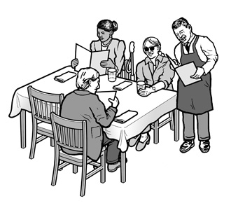
Communication - Print materials
Alternative formats - Braille, large print text, electronic format, audio recordings.
If little time to have it produced in an alternative format, reading the information aloud may be effective (Qualified Reader).
Example – reading what services you provide, etc.
Notes:
adjustable lighting, or a location with better lighting
assistance in filling out forms
Qualified reader is defined as “a person who is able to read effectively, accurately, and impartially, using any necessary specialized vocabulary.”
A health care provider cannot require a blind person to bring someone with them to interpret or facilitate communication

Slide 19
Common Scenario
Confidentiality Issues
Individuals, who are blind, often report feeling frustrated and embarrassed after being forced to reveal their confidential financial information or details about highly personal and private physical and mental health concerns out loud in public in front of strangers.
Notes:
the health care provider must furnish the alternative accessible formats in a timely manner, and in such a way as to protect the privacy and independence of the individual with a disability.
Think about using a private room, etc.

Slide 20
Intellectual and Cognitive Disabilities
Allow plenty of time to teach a new task.
Use repetition with precise language and simple wording.
Treat adults as adults and children as children.
Do not pretend to understand if you do not.
Notes:
DEFINITIONS:
An intellectual disability is a disability characterized by significant limitations both in intellectual functioning (reasoning, learning, problem solving) and in adaptive behavior, which covers a range of everyday social and practical skills and originates before the age of 18.
Cognitive impairments are not caused by any one disease or condition. Alzheimer’s disease and other dementias and conditions such as stroke and traumatic brain injury can cause cognitive impairment.
Taking extra time for patient appointment = reasonable accommodation = Modification of policies and procedures

Slide 21
Intellectual and Cognitive Disabilities
Ask additional questions to clarify any information a patient may be sharing with you.
Reduce distractions.
Use pictures or objects to convey meaning, if appropriate.
Allow a “wait time” for the patient to process information or respond to a question or to make a comment.

Slide 22
Auxiliary Aids and Services for Individuals with Speech Disabilities
speech synthesizers*
communication boards*
sign language interpreting
access to laptop computer/keyboard for typed communication, tablets/iPad, etc.
* Speech synthesizers and communication boards are personal devices. Medical offices should allow individuals to bring them and use them for effective communication purposes.
Notes:
Personal story -

Slide 23
Auxiliary Aids and Services for Individuals who are Deaf of Hard of Hearing
qualified ASL interpreters
note-takers
written materials
assistive listening systems/devices
closed caption decoders, open and closed captioning
TTYs/TDDs, telephone relay service, video phones, and video relay service
Communication Access Real-time Translation
exchange of written notes.
Notes:
Ineffective methods of communication
Lip/speech reading is frequently ineffective. Many factors reduce lip reading abilities (e.g. lighting, facial hair, foreign or regional accents). Many sounds cannot easily be read on the lips. Additionally, patients who are anxious, scared, fatigued, affected by medication, may all hinder the patient’s ability to effectively lip/speech read. Many deaf people, particularly in medical settings, will feign to understand and nod their heads in agreement. This is usually not an indication that they are understanding but as a result of feeling embarrassed to inform the health care professional that they are NOT able to understand. Teach-back is extremely important in assessing and ensuring patient’s understanding.
Hearing loss in older patients – baby boomers
Do not assume note writing is an effective communication tool. American Sign Language is not based on written or spoken English. The syntax and grammatical structure are very different from English. English is often a second language for many deaf people just as it is for people coming from other countries. Writing is also labor intensive and for many deaf people as well as health care providers, writing may be found to be cumbersome and inefficient in a medical setting.
Other Considerations:
Visual Medical Aids
Where necessary to facilitate patient education and communication use charts, diagrams, models and aids in the office to help explain certain concepts and basic anatomy. In addition, provide a list of online resources to reinforce teaching and understanding.

Slide 24
Deafness
For individuals who are deaf and use sign language, the most effective auxiliary aid or service which a medical office can provide is usually the service of qualified sign language interpreters, who are trained in medical terminology.
Notes:
Do all individuals who are deaf or hard of hearing use the same kind of interpreter?
No. There are various kinds of interpreters. The health care provider should ascertain the particular language needs of the deaf or hard of hearing patient before hiring an interpreter. Some individuals may require interpreters who are fluent in American Sign Language, Others may require interpreters who use Signed English. Still others who do not know any sign language may require oral interpreters, who take special care to articulate words for deaf or hard of hearing individuals

Slide 25
Effective Comm.
Notes:
Explain how scary and confusing this could be without an interpreter.
On the flip side, the deaf person may not know sign language and thus be denied Effective Communication

Slide 26
Common Scenario
A deaf patient ended up in hospital after a heart attack, attributed to medical error (medication prescribed without benefit of an interpreter)
(Medical Interpreting Task Force, WA State)

Slide 27
Qualified Sign Language Interpreter
“An interpreter who, via a video remote interpreting (VRI) service or an on-site appearance, is able to interpret effectively, accurately, and impartially, both receptively and expressively, using any necessary specialized vocabulary... includes sign language interpreters, oral transliterators and cued-language transliterators”.
28 C.F.R. § 35.104
Notes:
Interpreters providing services in a medical setting may need to be able to interpret medical terminology.
The ADA definition does not require certification.
State laws and regulations may impose additional requirements for interpreters.
The law that offers greater coverage and protection for people with disabilities applies.

Slide 28
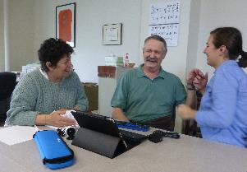
Common Scenarios
Asking sick children to interpret for their deaf parent
Pressuring a deaf man to lip-read and interpret for his deaf-blind wife
Ignoring request (including repeated requests) and relying on written notes
Notes:
Medical Interpreting Task Force, WA State
The Medical Interpreting Task Force for deaf, hard-of-hearing and deaf-blind people in the State of Washington (MITF) was convened in the Fall of 2012 to address increasingly serious concerns expressed by stakeholders.

Slide 29
Family Members as Interpreters?
No!
Family members do not meet the requirements of a “qualified” interpreter because they usually cannot remain impartial, and often do not have the language skills, or training to effectively and accurately interpret a medical appointment.
Notes:
To elaborate further -
Family members and friends are also very often too emotionally or personally involved, may have interests that conflict with the patient’s, may cause role confusion, and are unable to interpret “effectively, accurately, and impartially.” Finally, using family members and friends as interpreters can cause problems in maintaining patient confidentiality.
Family members may be used in an emergency involving imminent threat to safety or welfare of individual or public and no interpreter available, or where specific request by person with disability, accompanying adult agrees, and reliance on that person is appropriate under circumstances.
The ADA further prohibits the use of minor children as interpreters with the exception of emergencies and situations where the safety of others are at risk

Slide 30
Qualified Sign Language Interpreter
Recommendation:
Interpreters working in medical settings should have some form of national certification in addition to medical interpreter training.
Such certification and training serves as an indication of competence.

Slide 31
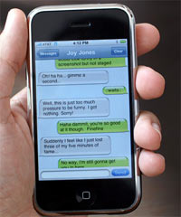
Communication - Simple situations
Brief or simple face-to-face exchanges - very basic aids are usually appropriate and effective.
For example, exchanging written notes may be effective when a deaf person asks for a copy of a form to fill out.
Using a “smart phone” to write and exchange messages.
Notes:
For brief or simple face-to-face exchanges, very basic aids are usually appropriate.
For example, exchanging written notes may be effective when a deaf person asks for a copy of a form at an office or for ordering food at a hospital cafeteria.
For more complex or lengthy exchanges, more advanced aids and services may be required. Consider how important the communication is, how many people are involved, the length of the communication anticipated, and the context.

Slide 32
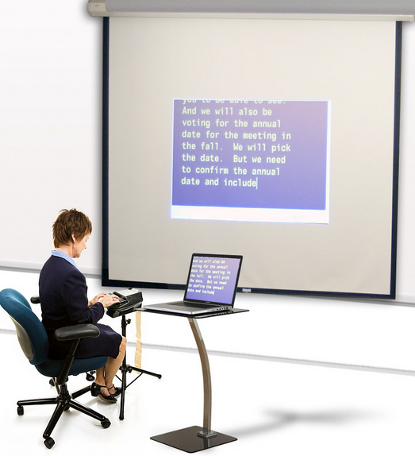
Communication - Complex situations
Complex or lengthy exchanges
an interpreter (sign language, oral, cued speech) or
CART (Communication Access Real-time Translation)
Examples – interviews, counseling sessions, community events, meetings, etc.
Written transcripts or closed captions on video for pre-scripted situations such as speeches, presentations, etc.
Notes:
Example: Blood pressure check

Slide 33
Video Remote Interpreting (VRI)
Definition:
“An interpreting service that uses video conferencing technology over dedicated lines or wireless technology offering high-speed, wide bandwidth video connection that delivers high quality video images...”
Notes:
Becoming more and more popular
ADAA requires specific technology requirements in order to provide effective VRI services

Slide 34
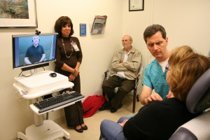
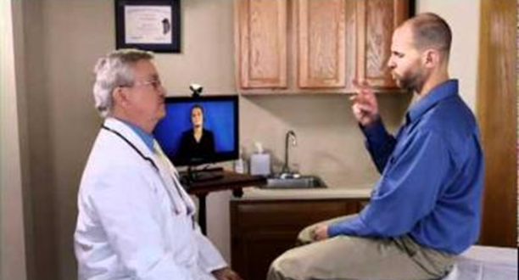
Video Remote Interpreting (VRI)
Notes:
Becoming more and more popular
ADAA requires specific technology requirements in order to provide effective VRI services

Slide 35
Video Remote Interpreting
New Regulations 35.160(d); 36.303(f)
Performance standards
Quality of video and audio
Dedicated high speed connection
Picture
Clear, sufficiently large, and sharply delineated
Heads, arms, fingers
Voices clear and easily understood transmission
Quick set-up and training of users

Slide 36
Problems with VRI Include:
Patient is prone
Patient is in pain or under the influence of substances (anesthesia, medications) that impair ability to focus on screen
Size and distance of the device – can’t see it well (e.g. laptop sized screen placed at the foot of the bed)
*Medical Interpreting Task Force

Slide 37
Problems with VRI Include:
Patient has visual impairments (e.g. deaf-blind) and cannot see the screen well/clearly
Equipment blocking visual sight lines
Insufficient signal strength, weak audio
Multiple deaf people (family members) cannot all see the screen and be seen by the camera
Interpreters (VRI) cannot see the context, identify who is entering/leaving, who is talking, what they are doing
Staff lack training how to use the device
Notes:
Patient has visual impairments (e.g. deaf-blind) and cannot see the screen well/clearly
Other equipment blocking visual sight lines between the patient and the screen/camera (e.g. bed rails, IV post and bag, moving providers) blocking the screen/camera view
Insufficient signal strength – image freezes/blurs
Small/weak audio speakers – providers can’t hear the interpreter (deaf patient) above the noise of all that’s going on (e.g. in an ED)
VRI interpreter may lack qualifications (especially for monolingual ASL patients, children, deaf patients from other countries, deaf patients with cognitive disabilities)
Multiple deaf people (family members) cannot all see the screen and be seen by the camera
Interpreters (VRI) cannot see the context, identify who is entering/leaving, who is talking, what they are doing
Staff lack training how to use the device – waste time setting it up, may not make the image full screen – in any case not visually aware about sight lines, distance, angles etc.

Slide 38
When VRI is Effective
When the patient is feeling able to sit up and to concentrate e.g. for non-serious visits to the ER, or as a patient is getting ready to be discharged
*Medical Interpreting Task Force

Slide 39
When VRI is Most Effective
The most effective communication for emergencies/urgent care is a combination of an on-call interpreter and VRI –
procedure of asking the deaf, hard-of-hearing or deaf-blind patient their most effective means of communication – (preference)
If requested, calling the on-call interpreter,
Meanwhile, if possible, using the VRI to get initial patient information
*Medical Interpreting Task Force
Notes:
Healthcare provider makes the call, as long as equally effective, given the situation.
Entities that rely solely on VRI services are at risk of not providing effective communication. If the equipment or internet connection fails, the staff doesn’t know where to find the equipment, or the situation is not appropriate for the use of VRI, and there is no other option of providing an in-person interpreter, the entity has not adequately provided access. This means the entity is not complying with the ADA. During emergencies, some entities call an in-person interpreter or agency first. While the interpreter is on route, the entity will use the VRI service until the interpreter arrives.

Slide 40
Choosing Appropriate VRI Provider
Many healthcare facilities have arrangements with remote language translation companies to provide translation for patients who speak other languages. Such companies add on ASL interpreting as one of their options:
Are these interpreters qualified?
Is interpreting for Deaf patients, a Disability Accommodation under the ADA, or a Language Accommodation?

Slide 41
Communication Access Realtime Translation
For individuals who are deaf but do not rely on sign language for communication and who have good levels of reading comprehension, the appropriate auxiliary aid or service is usually the use of transcription services, such as Communication Access Realtime Translation (CART).
28 C.F.R. § 35.104.
Notes:
CART converts spoken words instantly into text using a stenotype machine, computer, and special software.

Slide 42
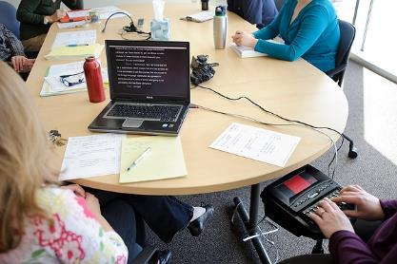
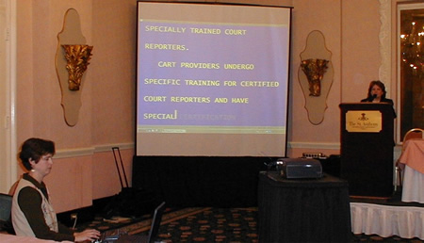
Communication Access Realtime Translation (CART)
Notes:
Examples:
Getting together with a HC team to discuss upcoming treatment, recovery, etc.
Large group presentations with two or more people – or

Slide 43
Undue Burden and Fundamental Alteration
The ADA does not require the provision of any auxiliary aid or service that would result in an undue burden or in a fundamental alteration in the nature of the goods or services provided by a health care provider.
28 C.F.R. § 36.303(a)
Notes:
A fundamental alteration is a change that is so significant that it alters the essential nature of the goods, services, facilities, privileges, advantages or accommodations offered by a business. In health care settlements, the Department of Justice has indicated that very rarely will this be a legitimate defense for failing to provide effective communication.
State and local governments: in determining whether a particular aid or service would result in undue financial and administrative burdens, a title II entity should take into consideration the cost of the particular aid or service in light of all resources available to fund the program, service, or activity and the effect on other expenses or operations. The decision that a particular aid or service would result in an undue burden must be made by a high level official, no lower than a Department head, and must include a written statement of the reasons for reaching that conclusion.
Businesses and nonprofits: in determining whether a particular aid or service would result in an undue burden, a title III entity should take into consideration the nature and cost of the aid or service relative to their size, overall financial resources, and overall expenses. In general, a business or nonprofit with greater resources is expected to do more to ensure effective communication than one with fewer resources. If the entity has a parent company, the administrative and financial relationship, as well as the size, resources, and expenses of the parent company, would also be considered.

Slide 44
Undue Burden and Fundamental Alteration
An individualized assessment is required to determine whether a particular auxiliary aid or service would be an undue burden.
Notes:
A fundamental alteration is a change that is so significant that it alters the essential nature of the goods, services, facilities, privileges, advantages or accommodations offered by a business. In health care settlements, the Department of Justice has indicated that very rarely will this be a legitimate defense for failing to provide effective communication.
State and local governments: in determining whether a particular aid or service would result in undue financial and administrative burdens, a title II entity should take into consideration the cost of the particular aid or service in light of all resources available to fund the program, service, or activity and the effect on other expenses or operations. The decision that a particular aid or service would result in an undue burden must be made by a high level official, no lower than a Department head, and must include a written statement of the reasons for reaching that conclusion.
Businesses and nonprofits: in determining whether a particular aid or service would result in an undue burden, a title III entity should take into consideration the nature and cost of the aid or service relative to their size, overall financial resources, and overall expenses. In general, a business or nonprofit with greater resources is expected to do more to ensure effective communication than one with fewer resources. If the entity has a parent company, the administrative and financial relationship, as well as the size, resources, and expenses of the parent company, would also be considered.

Slide 45
“But it Costs too Much!”
A health care provider is expected to treat the costs of providing auxiliary aids and services as part of the overhead costs of operating a business.
As long as the provision of the auxiliary aid or service does not impose an undue burden on the provider’s business, the provider is obligated to pay for the auxiliary aid or service.
Notes:
For example, a payment may be considered an undue burden or fundamental alteration if it would cause your doctor to go bankrupt or go out of business.
A loss on a single appointment or even providing ongoing care for a patient does not establish an undue burden or fundamental alteration. The overall financial circumstances of your doctor's practice must be considered.
Settlement agreements negotiated with the Department of Justice are clear. Being reimbursed less than the cost of services for a sign language interpreter is not considered an undue burden.
A health care provider cannot charge a patient for the costs of providing auxiliary aids and services, either directly or through the patient's insurance carrier.
Medicaid

Slide 46
Undue Burden and Fundamental Alteration
When an undue burden can be shown, the health care provider still has the duty to furnish an alternative auxiliary aid or service that would not result in an undue burden and, to the maximum extent possible, would ensure effective communication.
28 C.F.R. § 36.303(f).
Notes:
Example – new mental health counseling provider who is just starting a business.
Covered entities may require reasonable advance notice from people requesting aids or services, based on the length of time needed to acquire the aid or service, but may not impose excessive advance notice requirements. “Walk-in” requests for aids and services must also be honored to the extent possible.

Slide 47
Developing Policies and Procedures
Healthcare providers are encouraged to enact internal policies and procedures that address the specific communication needs of the entity and the patrons they serve.
Drafting policies and providing training on the protocols for arranging auxiliary aids and services keeps staff members informed with how to comply with the ADA
*Colorado Commission for the Deaf and Hard of Hearing
Notes:
A critical and often overlooked component of ensuring success is comprehensive and ongoing staff training. Covered entities may have established good policies, but if front line staff are not aware of them or do not know how to implement them, problems can arise. Covered entities should teach staff about the ADA's requirements for communicating effectively with people who have communication disabilities. Many local disability organizations, including Centers for Independent Living, conduct ADA trainings in their communities. The Department’s ADA Information Line can provide local contact information for these organizations.
Staff training: including how to set-up and operate Video Remote Interpreting services;

Slide 48
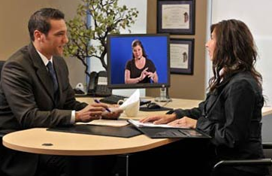
Establish an Effective Communication Office Policy
Frontline staff should ask deaf patients what their preferred communication needs are and document this in the patient’s medical records.
Build a database of qualified sign language interpreters and referral agencies with expertise in medical settings.
Notes:
“Do you have any special needs related to a disability that we can assist you with during your visit?”
Documentation should be clear on how any language or communication needs were addressed with each patient at each visit. This should also include any reason why accommodations were declined by the patient.
This database should be used as a reference for all medical situations that may come up in the future. Medical centers, including health care providers can contact various organizations to learn about potential listings of certified sign language interpreters: the a deaf and hard of hearing state commission, if one exists, the state association of the deaf, the National Association for the Deaf, as well as local chapters of the Registry of Interpreters for the Deaf (RID). The listing of interpreter agencies and certified interpreters should be freely available to any health care staff that is responsible for coordinating language and communication services for deaf patients.

Slide 49
An Effective Communication Policy Includes:
Definition of who is entitled to auxiliary aids and services (Persons who are deaf, visually impaired, companions, etc.)
Examples of services and auxiliary aids the entity has available
How to respond to a request for auxiliary aids (such as interpreters)
How long it should take to respond to requests
*Colorado Commission for the Deaf and Hard of Hearing

Slide 50
Ef
An Effective Communication Policy Includes:
Where devices (like assistive listening systems or VRI equipment) are stored
Names of subcontractors that provide auxiliary services (such as interpreters, CART, Braille)
Hours of when subcontractors are available to provide services
Procedures for obtaining a qualified interpreter last minute or during an emergency
*Colorado Commission for the Deaf and Hard of Hearing

Slide 51
1
An Effective Communication Policy Includes:
When it is appropriate to exchange written notes and when an interpreter should be called
Who is considered a “qualified interpreter”
Language about friends, family, children and impartial parties being unqualified to interpret
Appropriate and inappropriate times and settings to use Video Remote Interpreting (if applicable)
*Colorado Commission for the Deaf and Hard of Hearing

Slide 52
Resources
Regulations, appendices, standards are available at DOJ’s ADA web site at www.ada.gov
For answers to specific questions, DOJ toll-free ADA information line:
800-514-0301 (Voice)
800-514-0383 (TTY)
Network of ADA Centers: 800-949-4232 (Voice/TTY)
U.S. Access Board www.access-board.gov

Slide 53
Resources
National Association of the Deaf http://www.nad.org
National Federation of the Blind https://nfb.org
Registry of Interpreters for the Deaf http://www.rid.org
Notes:
National

Slide 54
Common State Resources
Disability-related Agencies
State Office of Deaf and Hard of Hearing Services
Deaf and Hard of Hearing Regional Centers
Department of Services for the Blind
Council for the Blind
Interpreter Referral Agencies

Slide 55
Sources
ADA.gov. (2003-Oct.). ADA Business BRIEF: Communicating with People Who Are Deaf or Hard of Hearing in Hospital Settings. Retrieved from https://www.ada.gov/hospcombr.htm
NAD. (nd.¹). Health Care Providers. Retrieved from https://www.nad.org/resources/health-care-and-mental-health-services/health-care-providers/
NAD. (nd.²). Position Statement On Health Care Access For Deaf Patients. Retrieved from https://www.nad.org/about-us/position-statements/position-statement-on-health-care-access-for-deaf-patients/
NW ADA Center. (2016-Mar. 2). Effective Communication: Healthcare. Retrieved from http://nwadacenter.org/factsheet/effective-communication-healthcare
US DOJ. (2014-Jan. 31). ADA Effective Communication Requirement. Retrieved from https://www.ada.gov/effective-comm.htm

Slide 56
Sources
ADA.gov. (2003-Oct.). ADA Business BRIEF: Communicating with People Who Are Deaf or Hard of Hearing in Hospital Settings. Retrieved from https://www.ada.gov/hospcombr.htm
NAD. (nd.¹). Health Care Providers. Retrieved from https://www.nad.org/resources/health-care-and-mental-health-services/health-care-providers/
NAD. (nd.²). Position Statement On Health Care Access For Deaf Patients. Retrieved from https://www.nad.org/about-us/position-statements/position-statement-on-health-care-access-for-deaf-patients/
NW ADA Center. (2016-Mar. 2). Effective Communication: Healthcare. Retrieved from http://nwadacenter.org/factsheet/effective-communication-healthcare
US DOJ. (2014-Jan. 31). ADA Effective Communication Requirement. Retrieved from https://www.ada.gov/effective-comm.htm

Slide 57
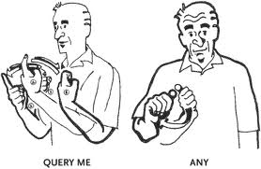
Questions?

